Slide 1
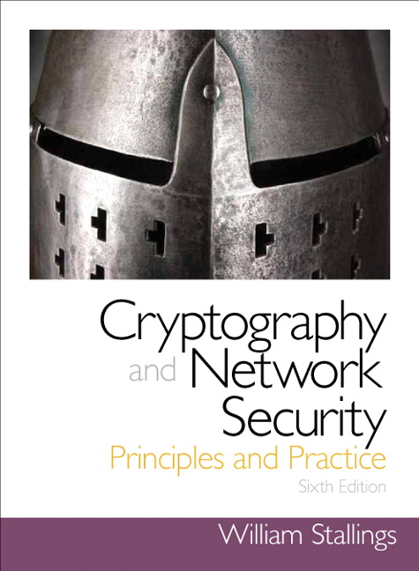
Cryptography and Network Security
Sixth Edition
by William Stallings
Notes:
Lecture slides prepared for “Cryptography and Network Security”, 6/e, by William Stallings, Chapter 8 – “More Number Theory”.

Slide 2
Chapter 8
More Number Theory
Notes:
A number of concepts from number theory are essential in the design of public-key
cryptographic algorithms. This chapter provides an overview of the concepts referred to
in other chapters. The reader familiar with these topics can safely skip this chapter. The
reader should also review Sections 4.1 through 4.3 before proceeding with this chapter.
As with Chapter 4, this chapter includes a number of examples, each of which is
highlighted in a shaded box.

Slide 3
The Devil said to Daniel Webster: “Set me a task I can’t carry out, and I’ll give you
anything in the world you ask for.”
Daniel Webster: “Fair enough. Prove that for n greater than 2, the equation
a^{n} + b^{n} = c^{n} has no non-trivial solution in the integers.”
They agreed on a three-day period for the labor, and the Devil disappeared.
At the end of three days, the Devil presented himself, haggard, jumpy, biting
his lip. Daniel Webster said to him, “Well, how did you do at my task? Did you
prove the theorem?”
“Eh? No … no, I haven’t proved it.”
“Then I can have whatever I ask for? Money? The Presidency?”
“What? Oh, that—of course. But listen! If we could just prove the following
two lemmas—”
—The Mathematical Magpie,
Clifton Fadiman
Notes:
Opening quote. A number of concepts from number theory are essential in the design of public-key cryptographic algorithms, which this chapter will introduce.

Slide 4
Prime Numbers
Prime numbers only have divisors of 1 and itself
They cannot be written as a product of other numbers
Prime numbers are central to number theory
Any integer a > 1 can be factored in a unique way as
a = _{p1} ^{a1} * p₂ ^{a2} * . . . * p_{p1} ^{a1}
where p₁ < p₂ < . . . < p_{t} are prime numbers and where each a_{i} is a positive integer
This is known as the fundamental theorem of arithmetic
Notes:
An integer p > 1 is a prime number if and only if its only divisors are ±1
and ± p . Prime numbers play a critical role in number theory and in the techniques
discussed in this chapter.
Any integer a > 1 can be factored in a unique way as
a = _{p1} ^{a1} * p₂ ^{a2} * . . . * p_{p1} ^{a1}
where p₁ < p₂ < . . . < p_{t} are prime numbers and where each a_{i} is a positive integer
This is known as the fundamental theorem of arithmetic

Slide 5
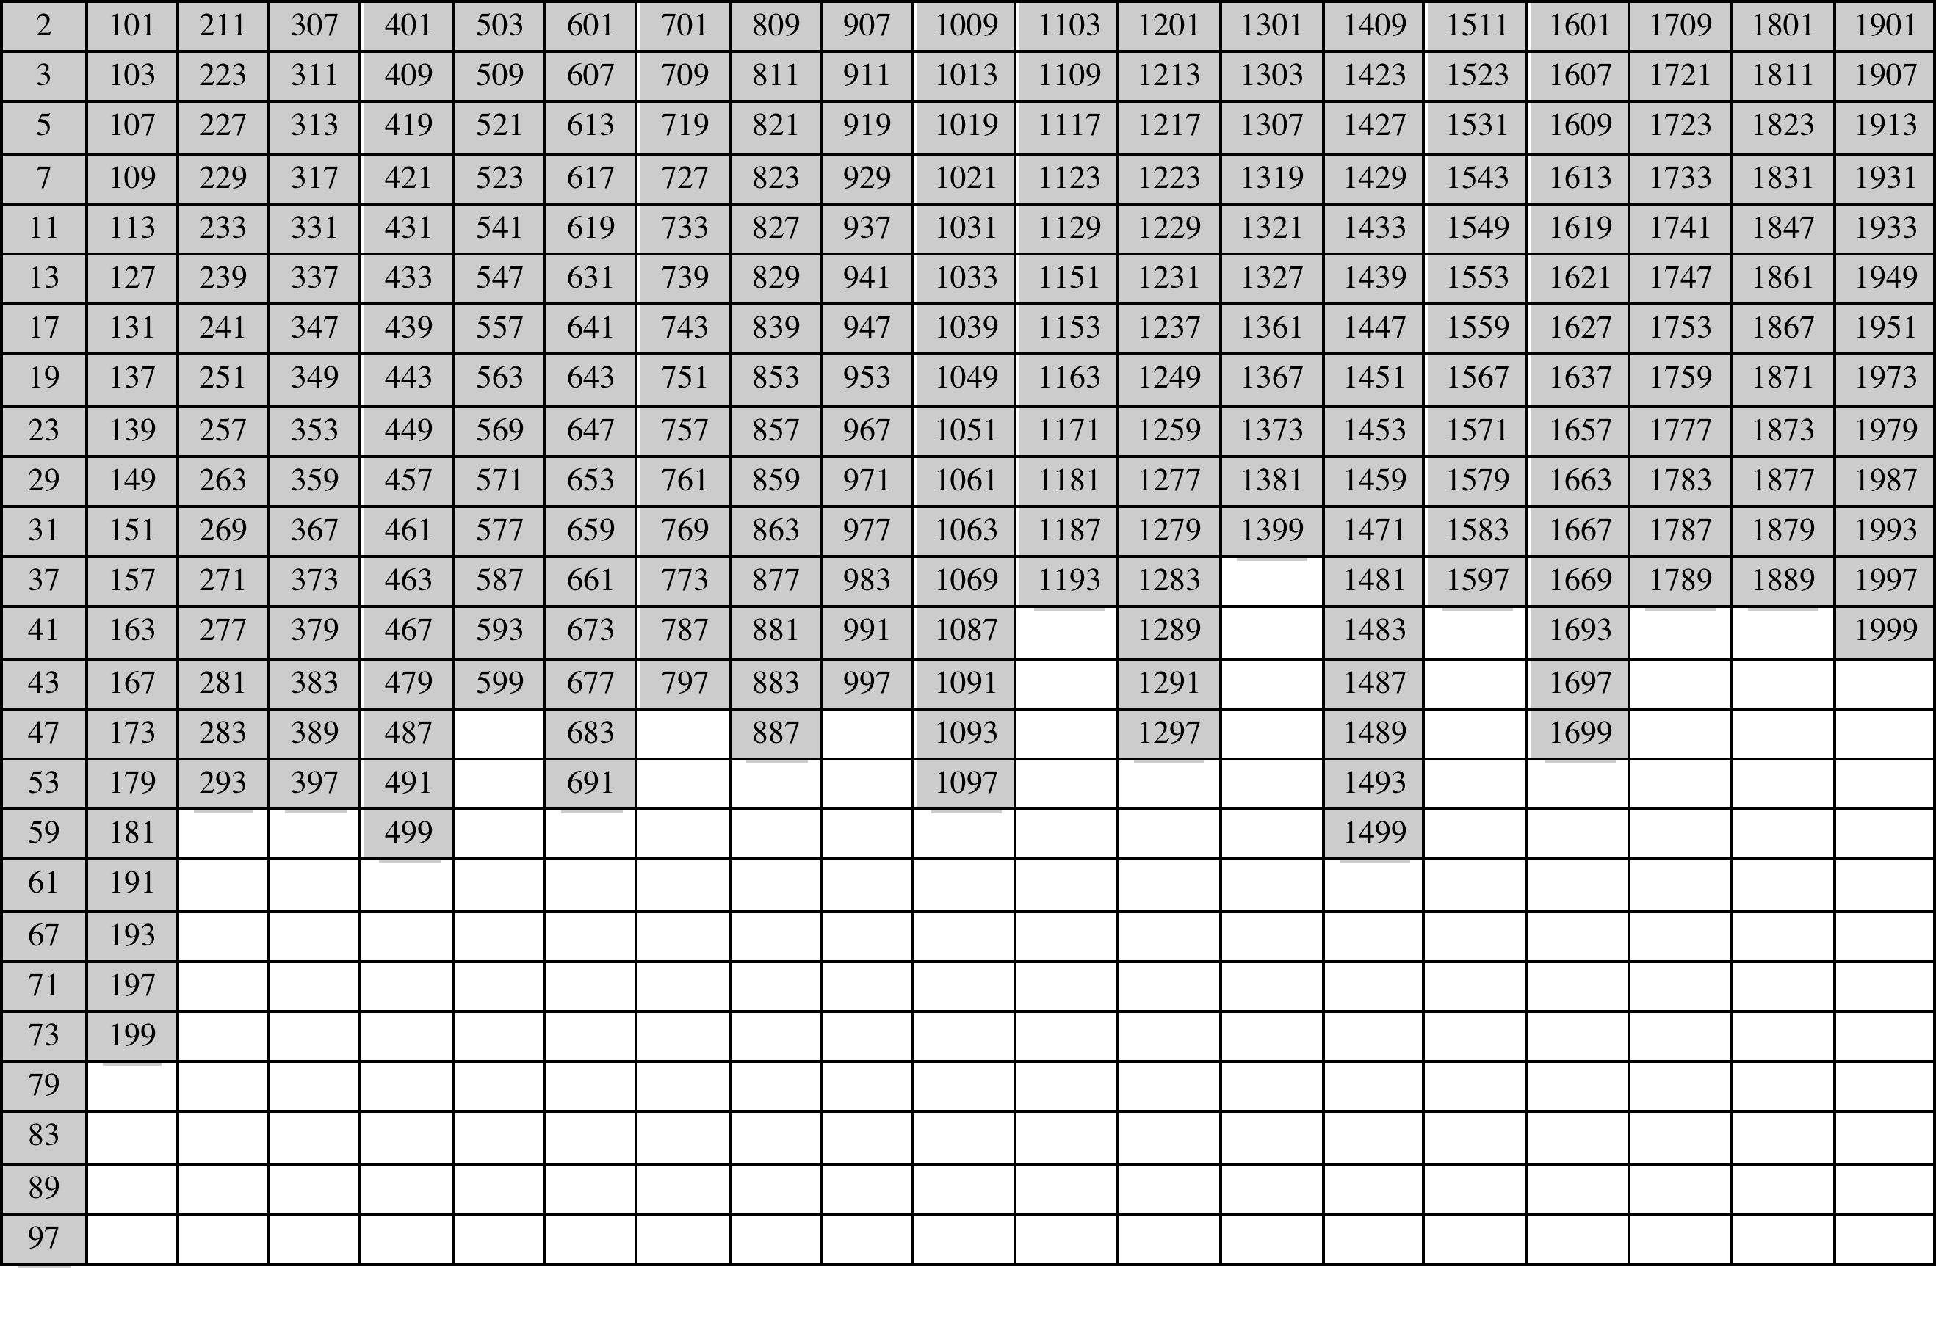
Table 8.1
Primes Under 2000
Notes:
Table 8.1 shows the primes less than 2000. Note the way
the primes are distributed. In particular, note the number of primes in each range
of 100 numbers.

Slide 6
Fermat's Theorem
States the following:
If p is prime and a is a positive integer not divisible by p then
a^{p-1} = 1 (mod p)
Sometimes referred to as Fermat’s Little Theorem
An alternate form is:
If p is prime and a is a positive integer then
a^{p} = a (mod p)
Plays an important role in public-key cryptography
Notes:
Two theorems that play important roles in public-key cryptography are Fermat’s
theorem and Euler’s theorem.
Fermat’s theorem states the following: If p is prime and a is a positive integer not
divisible by p, then
a^{p-1} = 1 (mod p)
An alternative form of Fermat’s theorem is also useful: If p is prime and a is a
positive integer, then
a^{p} = a (mod)

Slide 7
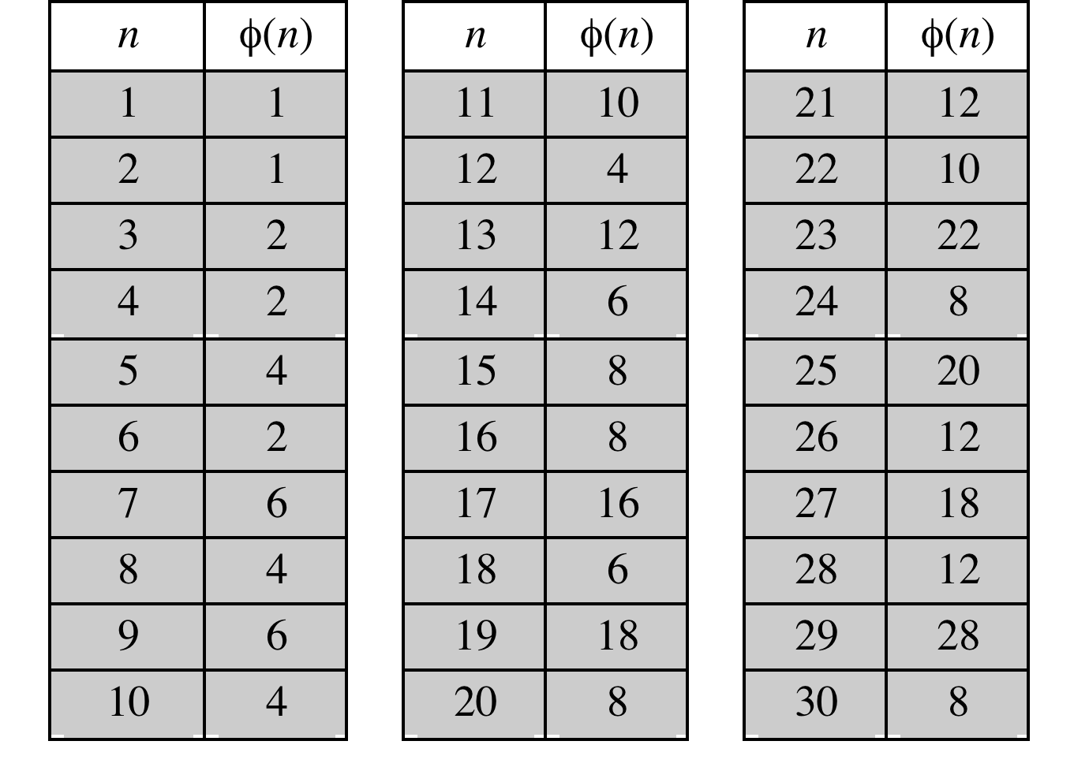
Table 8.2 Some Values of Euler’s Totient Function ø(n)
Notes:
Before presenting Euler’s theorem, we need to introduce an important quantity in
number theory, referred to as Euler’s totient function, written ø (n ), and defined as
the number of positive integers less than n and relatively prime to n . By convention,
ø(1) = 1.
Table 8.2 lists the first 30 values of ø (n ). The value ø(1) is without meaning
but is defined to have the value 1.
It should be clear that, for a prime number p ,
ø (p ) = p - 1

Slide 8
Euler's Theorem
States that for every a and n that are relatively prime:
a^{ø(n)} = 1(mod n)
An alternative form is:
a^{ø(n)+1} = a(mod n)
Plays an important role in public-key cryptography
Notes:
Euler’s theorem states that for every a and n that are relatively prime:
a^{ø(n)} = 1(mod n)
As is the case for Fermat’s theorem, an alternative form of the theorem is also
Useful:
a^{ø(n)+1} = a(mod n)

Slide 9
Miller-Rabin Algorithm
Typically used to test a large number for primality
Algorithm is:
TEST (n)
Notes:
For many cryptographic algorithms, it is necessary to select one or more very large
prime numbers at random. Thus, we are faced with the task of determining whether
a given large number is prime. There is no simple yet efficient means of accomplishing
this task.
In this section, we present one attractive and popular algorithm. You may be
surprised to learn that this algorithm yields a number that is not necessarily a prime.
However, the algorithm can yield a number that is almost certainly a prime. This
will be explained presently. We also make reference to a deterministic algorithm
for finding primes. The section closes with a discussion concerning the distribution
of primes.
The algorithm due to Miller and Rabin [MILL75, RABI80] is typically used to test
a large number for primality.
The procedure TEST takes a candidate integer n as input and returns the result composite
if n is definitely not a prime, and the result inconclusive if n may or may not
be a prime.
How can we use the Miller-Rabin algorithm to determine with a high degree of confidence whether or not an integer
is prime? It can be shown [KNUT98] that given an odd number n that is not prime
and a randomly chosen integer, a with 1 < a < n - 1, the probability that TEST
will return inconclusive (i.e., fail to detect that n is not prime) is less than 1/4.
Thus, if t different values of a are chosen, the probability that all of them will pass
TEST (return inconclusive) for n is less than (1/4)^{t} . For example, for t = 10, the
probability that a nonprime number will pass all ten tests is less than 10⁻⁶ . Thus,
for a sufficiently large value of t, we can be confident that n is prime if Miller’s test
always returns inconclusive .
This gives us a basis for determining whether an odd integer n is prime
with a reasonable degree of confidence. The procedure is as follows: Repeatedly
invoke TEST (n) using randomly chosen values for a . If, at any point, TEST returns
composite , then n is determined to be nonprime. If TEST continues to
return inconclusive for t tests, then for a sufficiently large value of t , assume
that n is prime.

Slide 10
Deterministic Primality Algorithm
Prior to 2002 there was no known method of efficiently proving the primality of very large numbers
All of the algorithms in use produced a probabilistic result
In 2002 Agrawal, Kayal, and Saxena developed an algorithm that efficiently determines whether a given large number is prime
Known as the AKS algorithm
Does not appear to be as efficient as the Miller-Rabin algorithm
Notes:
Prior to 2002, there was no known method of efficiently proving the primality of very
large numbers. All of the algorithms in use, including the most popular (Miller-Rabin),
produced a probabilistic result. In 2002 (announced in 2002, published in 2004),
Agrawal, Kayal, and Saxena [AGRA04] developed a relatively simple deterministic
algorithm that efficiently determines whether a given large number is a prime. The algorithm,
known as the AKS algorithm, does not appear to be as efficient as the Miller-
Rabin algorithm. Thus far, it has not supplanted this older, probabilistic technique.

Slide 11
Chinese Remainder Theorem (CRT)
Believed to have been discovered by the Chinese mathematician Sun-Tsu in around 100 A.D.
One of the most useful results of number theory
Says it is possible to reconstruct integers in a certain range from their residues modulo a set of pairwise relatively prime moduli
Can be stated in several ways
Notes:
One of the most useful results of number theory is the Chinese remainder theorem
(CRT). In essence, the CRT says it is possible to reconstruct integers in a certain
range from their residues modulo a set of pairwise relatively prime moduli.
The CRT can be stated in several ways. We present here a formulation that is most
useful from the point of view of this text. An alternative formulation is explored in
Problem 8.17.
One of the useful features of the Chinese remainder theorem is that it provides
a way to manipulate (potentially very large) numbers mod M in terms of tuples of
smaller numbers. This can be useful when M is 150 digits or more. However, note
that it is necessary to know beforehand the factorization of M .

Slide 12
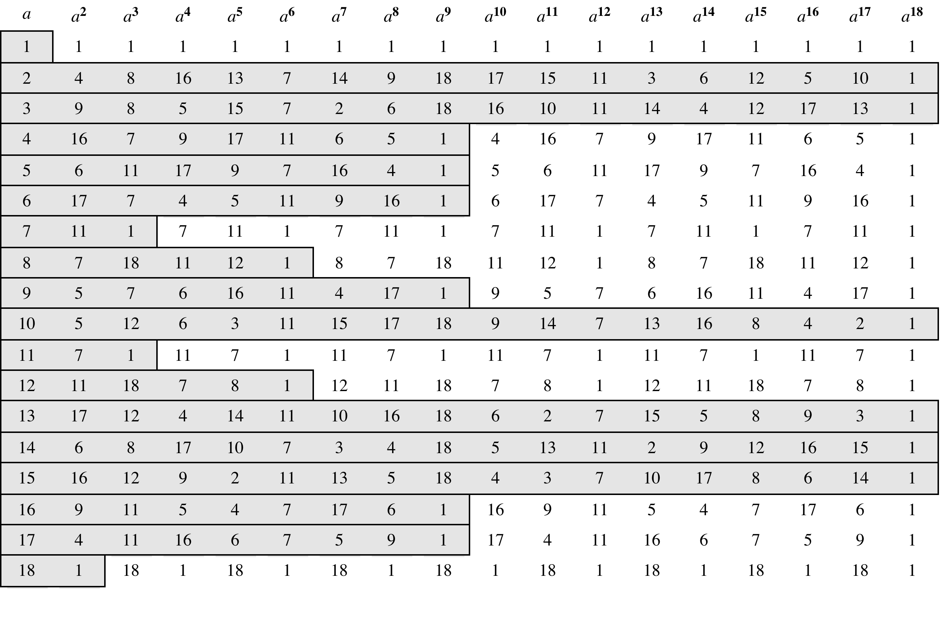
Table 8.3
Powers of Integers, Modulo 19
Notes:
Table 8.3 shows all the powers of a , modulo 19 for all positive ø <19. The
length of the sequence for each base value is indicated by shading. Note the
following:
1. All sequences end in 1. This is consistent with the reasoning of the preceding
few paragraphs.
2. The length of a sequence divides ø (19) = 18. That is, an integral number of
sequences occur in each row of the table.
3. Some of the sequences are of length 18. In this case, it is said that the base
integer a generates (via powers) the set of nonzero integers modulo 19. Each
such integer is called a primitive root of the modulus 19.
More generally, we can say that the highest possible exponent to which a number
can belong (mod n ) is ø (n ). If a number is of this order, it is referred to as a
primitive root of n . The importance of this notion is that if a is a primitive root of n ,
then its powers
a , a² ,. . . , a^{ø(n)}
are distinct (mod n ) and are all relatively prime to n . In particular, for a prime number
p , if a is a primitive root of p , then
a , a² ,. . . , a^{p-1}
are distinct (mod p ). For the prime number 19, its primitive roots are 2, 3, 10, 13, 14,
and 15.
Not all integers have primitive roots. In fact, the only integers with primitive
roots are those of the form 2, 4, pª , and 2pª , where p is any odd prime and a is a
positive integer. The proof is not simple but can be found in many number theory
books, including [ORE76].

Slide 13
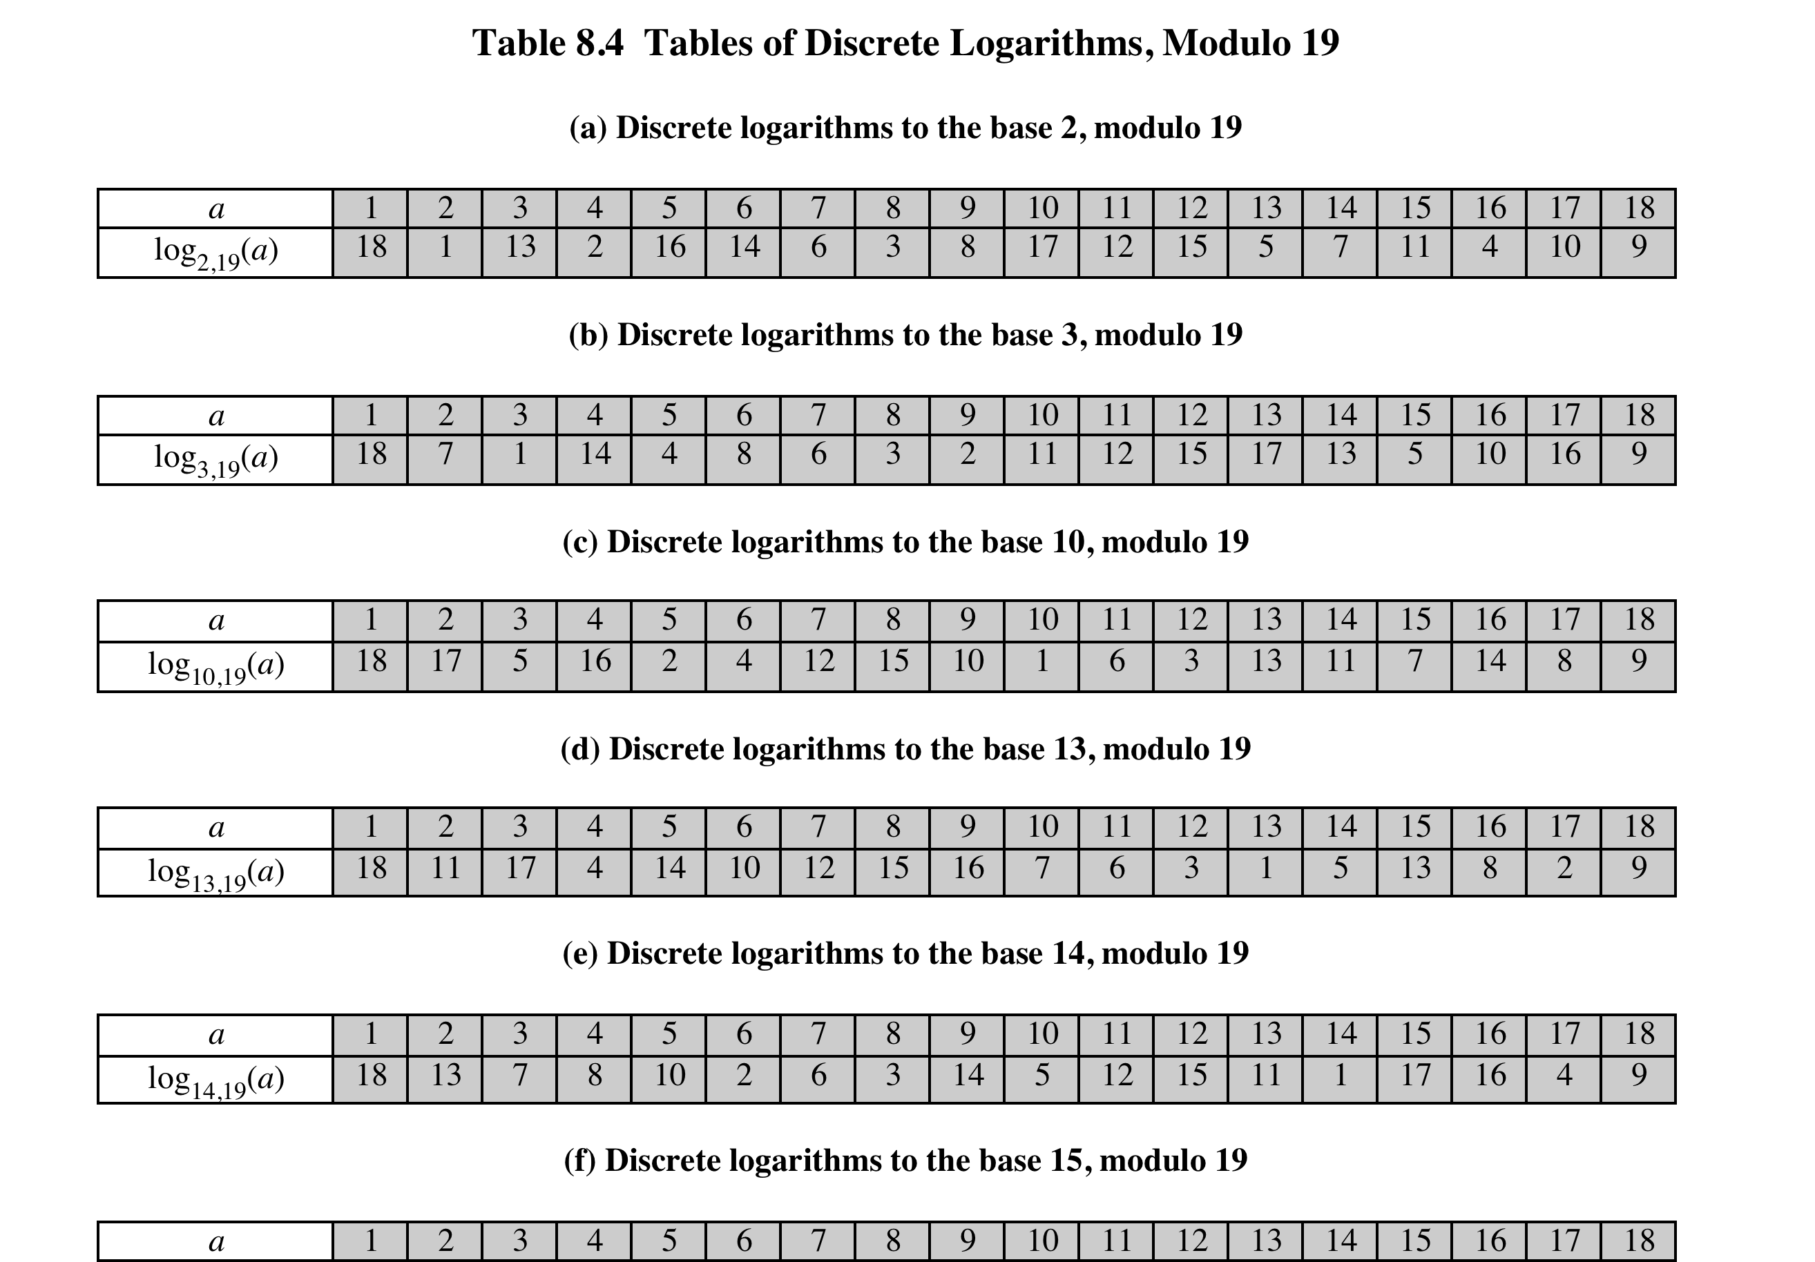
Notes:
Table 8.4, which is directly derived from Table 8.3, shows the sets of discrete
logarithms that can be defined for modulus 19.

Slide 14
Summary
Prime numbers
Fermat’s Theorem
Euler’s totient function
Euler’s Theorem
Testing for primality
Miller-Rabin algorithm
A deterministic primality algorithm
Distribution of primes
The Chinese Remainder Theorem
Discrete logarithms
Powers of an integer, modulo n
Logarithms for modular arithmetic
Calculation of discrete logarithms
Notes:
Chapter 8 summary.

